Slide 1
Understanding the Context
Module 1 – Motivational counseling training
Country, Year

Slide 2

What do the data tell us about key populations?

Slide 3
HIV prevalence of key populations vs. overall population
HIV prevalence among sex workers: 10 times higher than general population
Gay men and other men who have sex with men: 24 times more likely to be living with HIV than general population
Transgender women: 49 times more likely to be living with HIV than other adults of reproductive age
*Source: UNAIDS 2016 Prevention Gap Report
?
?
?

Slide 4
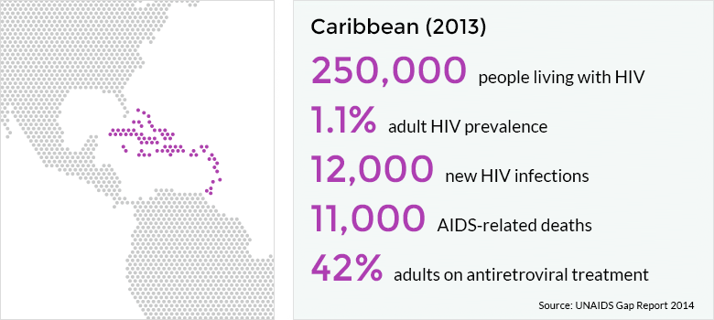
Placeholder – to be replaced with local data (highlight new infections with rectangle)

Slide 5
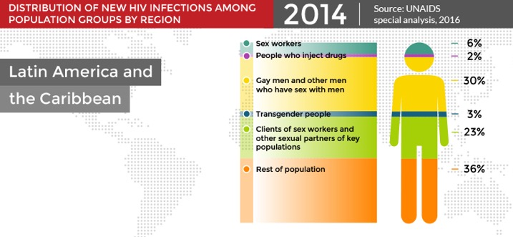
Placeholder – to be replaced with local data

Slide 6
What is within our power to change the direction of the epidemic?
Knowledge?
Attitudes?
Behaviors?
How do we motivate people to make changes?

Slide 7
Risk Meter Exercise

Slide 8
What is a PROBABILITY?

Slide 9
50% chance of rain

Slide 10
1 in 100 people are winners

Slide 11
The probability of an event =
The number of ways something can happen
The number of possible outcomes

Slide 12
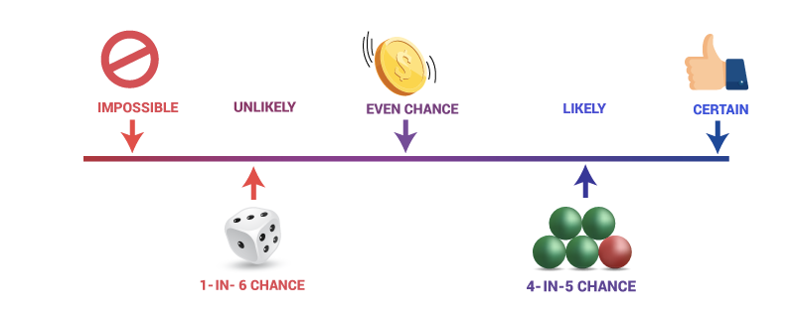
Examples of probabilities

Slide 13



Types of HIV transmission and probability of infection
Type of Exposure | Estimated risk per 1,000 exposures
Parenteral
Blood transfusion | 900
Needle-sharing during injection drug use | 7
Percutaneous (needle-stick) | 3
Sexual
Receptive anal intercourse | 5
Receptive peno-vaginal intercourse | 1
Insertive anal intercourse | 1
Insertive peno-vaginal intercourse | 0.5
Unprotected sex with HIV-infected individuals on ART | <0.13
Mother to child
Without prevention measures | 250
With prevention measures including ARV prophylaxis | 10
Source: adapted from www.cdc.gov

Slide 14
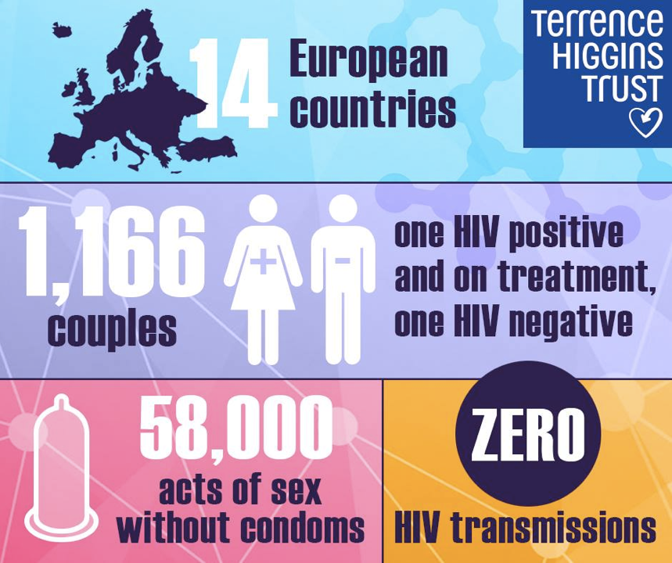

?

Slide 15
Cascade Exercise

Slide 16
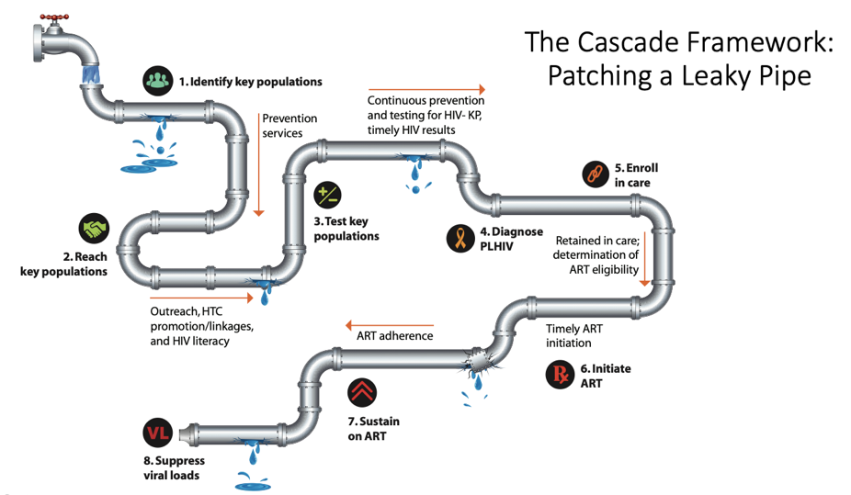
Levels of reflection: Simple

Slide 17
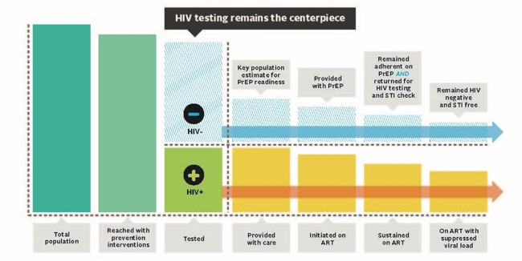
Testing: the centerpiece

Slide 18
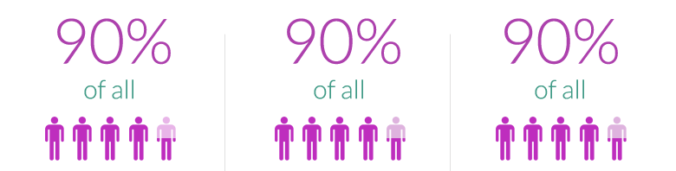



95%
95%
95%

Slide 19

What we do to motivate others matters…
…to help them protect, test, disclose, refer, and start and stay on treatment.

Slide 20
We are now entering the realm of motivational counseling

Slide 21
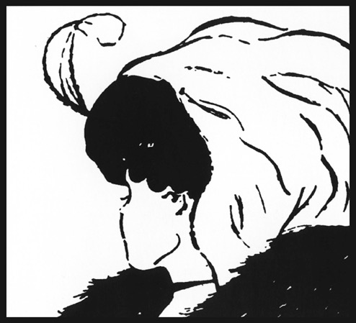

Slide 22
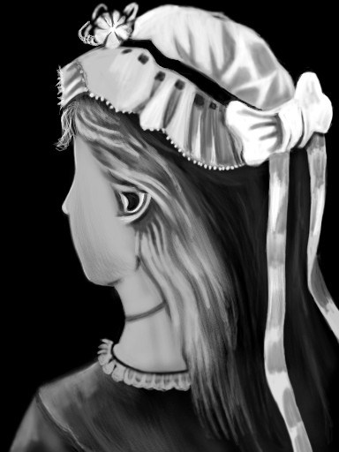

Slide 23
The Cash Register Story
A businessman had just turned off the lights in a store when a man appeared and demanded money. The owner opened a cash register. The contents of the cash register were scooped up, and the man sped away. A member of the police force was notified promptly.

Slide 24
Questions?

